Slide 1




OPC UA Security
Demo / Hands-On Instructions
Ralph Lange

Slide 2
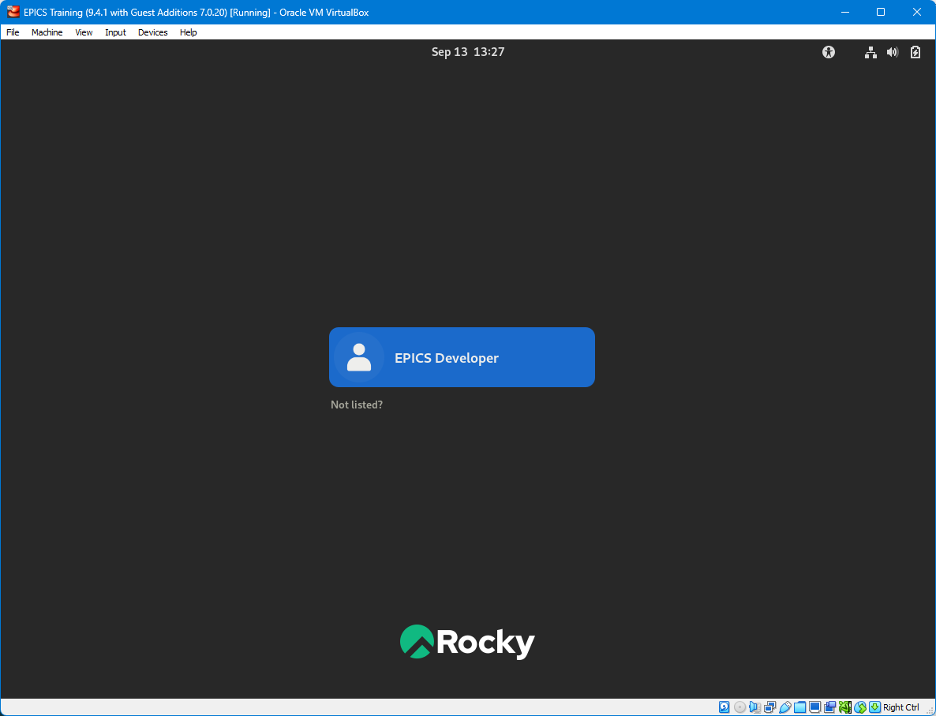
Log Onto the Training-VM

Slide 3
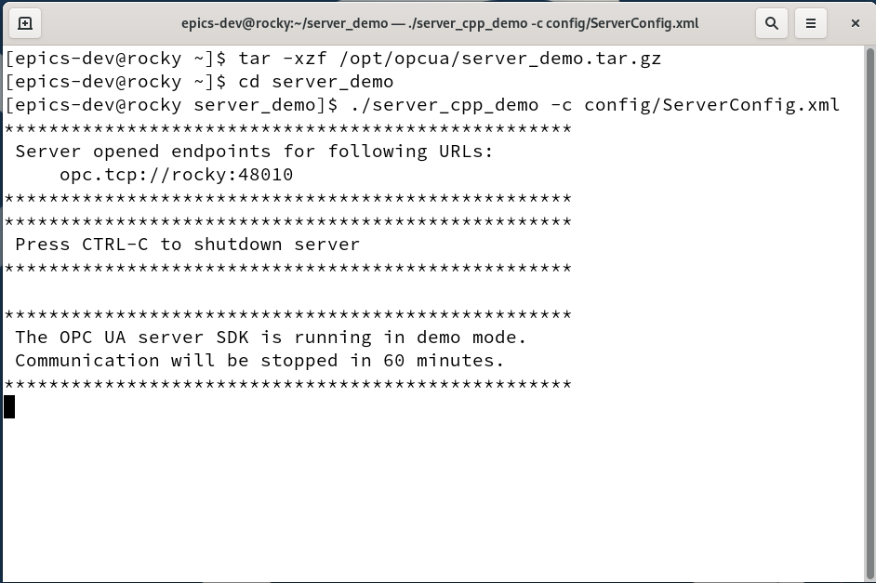
Start the Demo Server
Open a new terminal
Unpack the Unified Automation demo server
Run it
Use CTRL-C and restart it to simulate an orderly server disconnect and reconnect
Use CTRL-Z and “fg” to simulate network hang-up

Slide 4
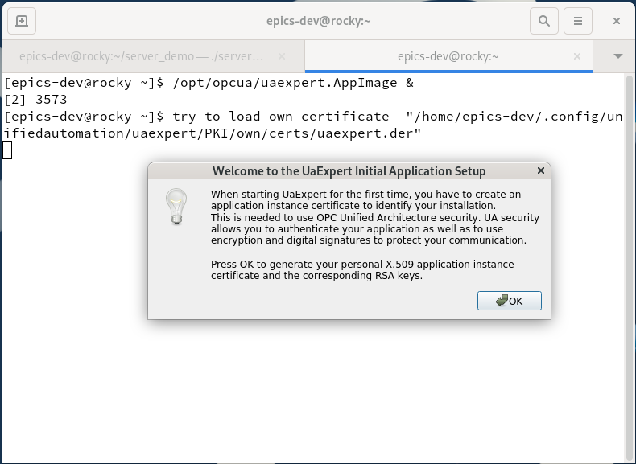
Start the UaExpert Browser
The first start requires you to create a self-signed certificate. Just enter any data.

Slide 5
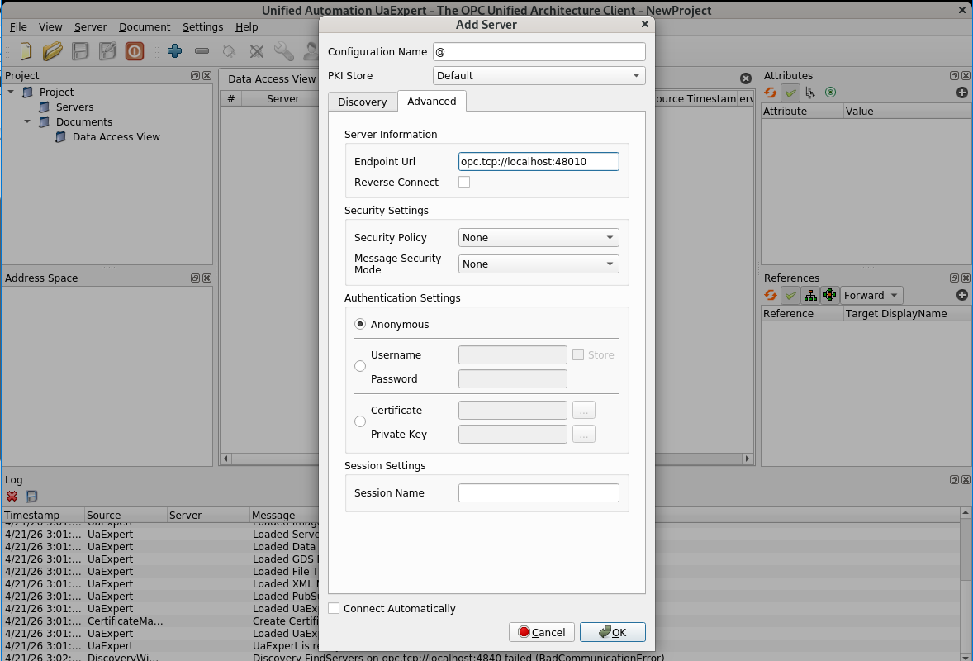
UaExpert: Add the Demo Server
Select Server, then Add…
Use the Advanced tab and enter the endpoint URL
opc.tcp://localhost:48010

Slide 6
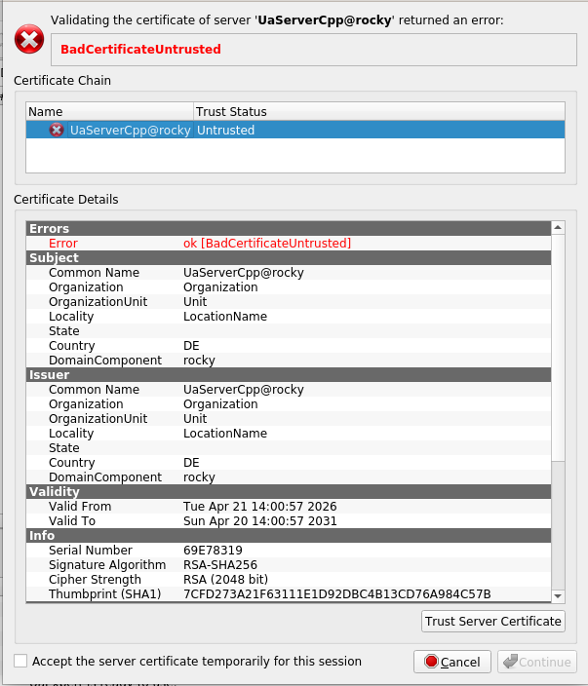
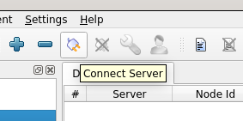
UaExpert: Connect
Connect by clicking on the Connect Server icon
Trust the unknown self-signed server certificate
and Continue

Slide 7
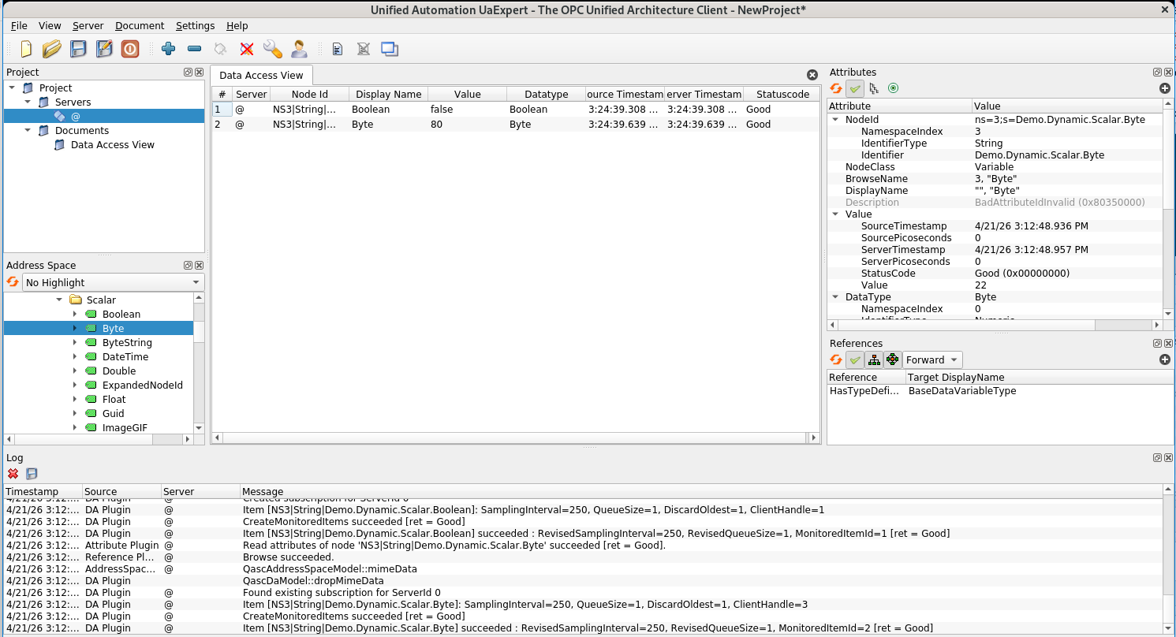
UaExpert: Familiarize Yourself
Inspect
Monitor
Browse

Slide 8
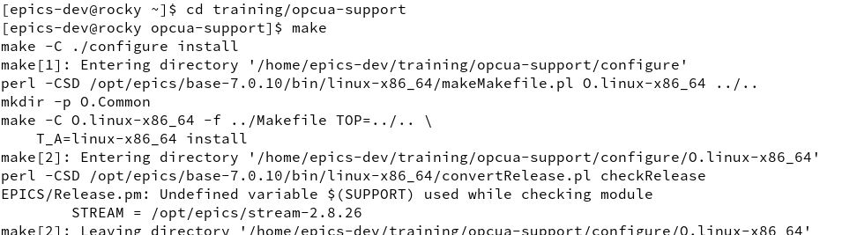
Build the IOC Two Steps
Change directory into the application cd training/opcua-support
Build the example IOC make

Slide 9
Run the IOC
Change into the IOC’s startup directory
Run the IOC binary, giving the name of the startup file as argument
Using a subshell avoids having to change directory all the time
( cd iocBoot/iocUaDemoServer/; ../../bin/linux-x86_64/opcuaIoc st.cmd )
Always do a clean exit of the IOC, using CTRL-D or the exit command OPC UA servers don’t free their session resources when a connection breaks – if the same session is reconnected, it just continues

Slide 10
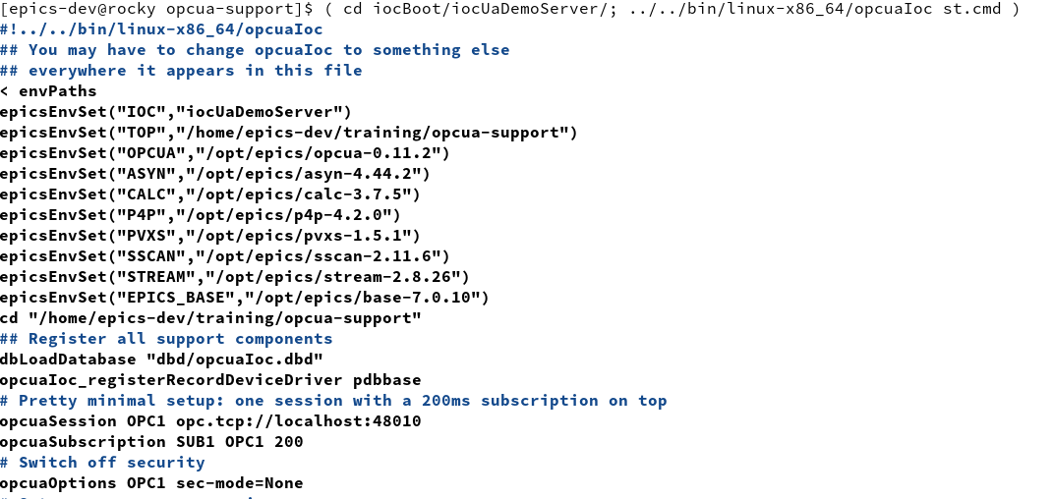
Run the IOC

Slide 11
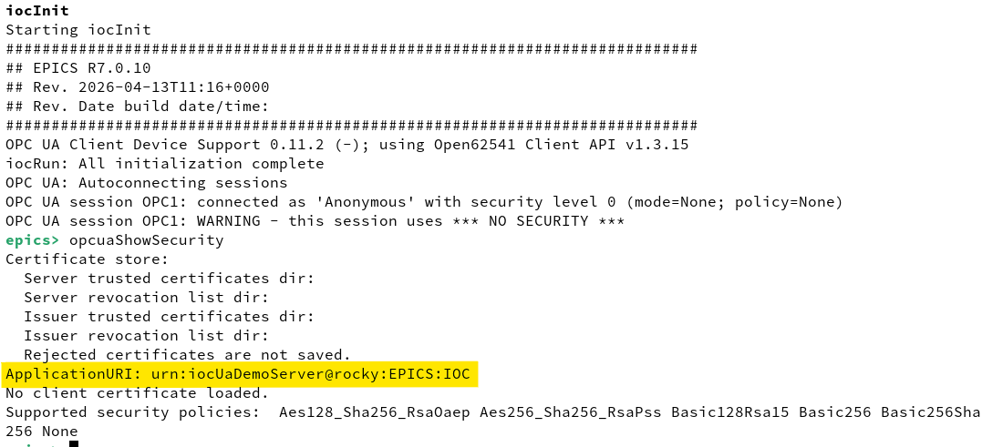
Find out the IOC’s URI

Slide 12
Prepare the xca Cert Manager
Powerful free Certificate and Key Management tool
Available on Linux, Windows, MacOS
Supports many key and certificate formats (including ssh)
Supports CA-based workflows (including sub-CA hierarchies) Nice visualization of CA signature chains
Allows to save and load templates Great help in creating correct certificates efficiently
Keeps keys, certs and templates in a database

Slide 13
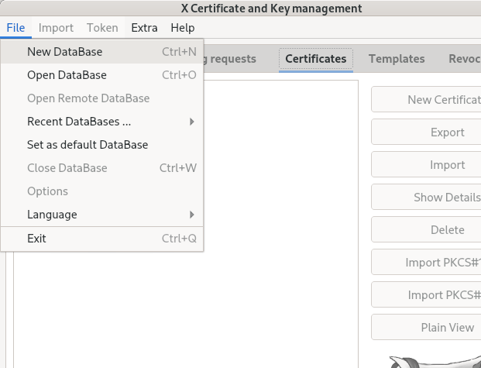
Create the xca Database
Start
Then File -> New DataBase
Give it a name
You can leave it without a password

Slide 14
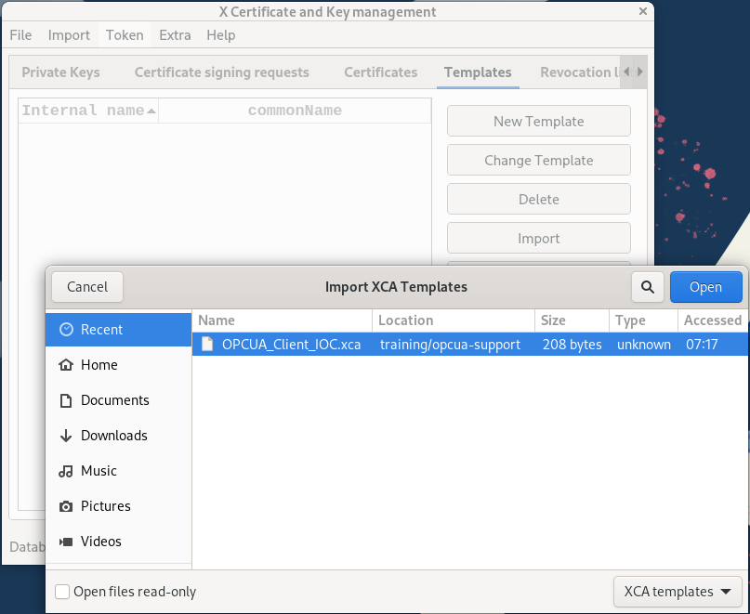
Import the IOC Cert Template
Tab Templates
Button Import
Select the template OPCUA_Client_IOC
This loads the template from the file into the xca database

Slide 15
Prepare the Secure Connection
Set up the Client Certificate
Create the Key Pair and self-signed Client Certificate for the IOC
st.cmd: switch the IOC to use security
st.cmd: load the self-signed Client Certificate and its private key
Establish trust
Copy the Client Certificate into the server’s trusted/certs list
Copy the Server Certificate into the IOC’s trusted/certs list
Connect!

Slide 16
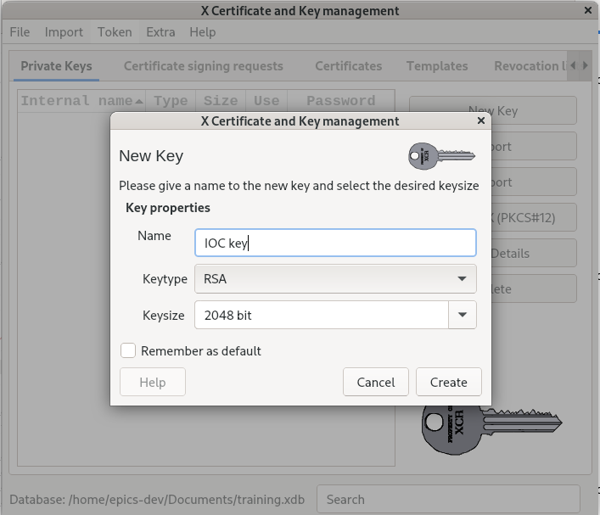
Create a Key Pair for the IOC
Tab Private Keys
Button New Key
Call it IOC key

Slide 17
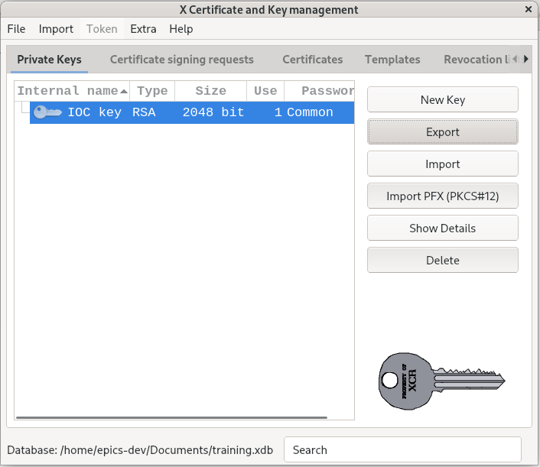
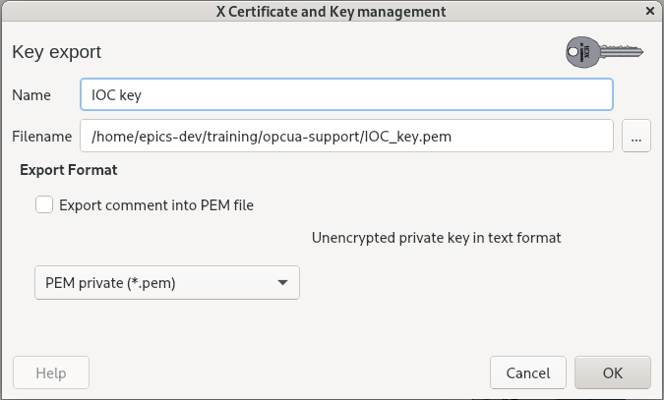
Export the IOC Private Key
Tab Private Keys
Select the key
Button Export
Select PEM format
Click OK

Slide 18
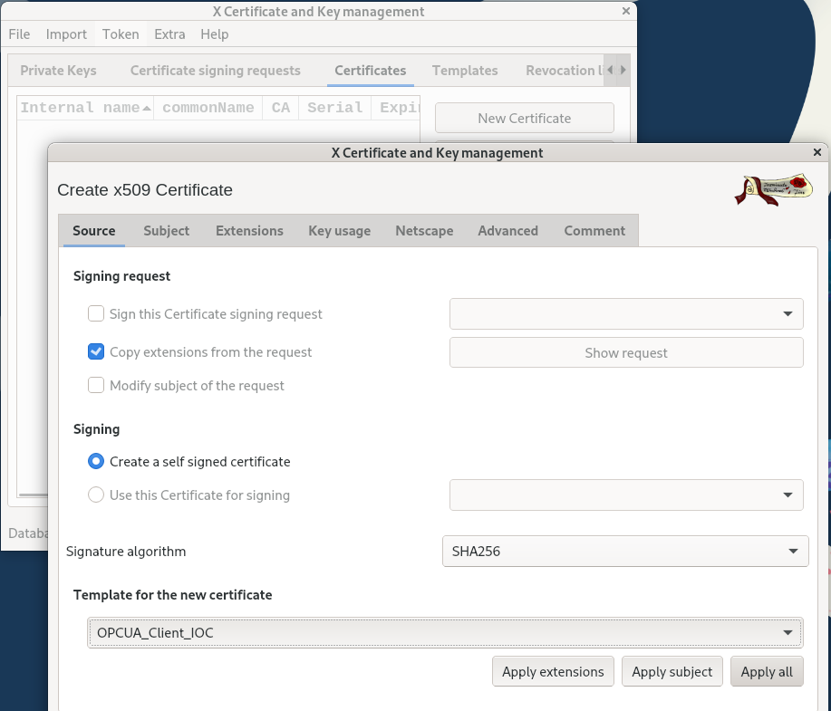
Create the IOC’s Client Certificate
Tab Certificates
Button New Certificate
Sub-Tab Source
Make it self-signed
Select and fully apply the template OPCUA_Client_IOC

Slide 19
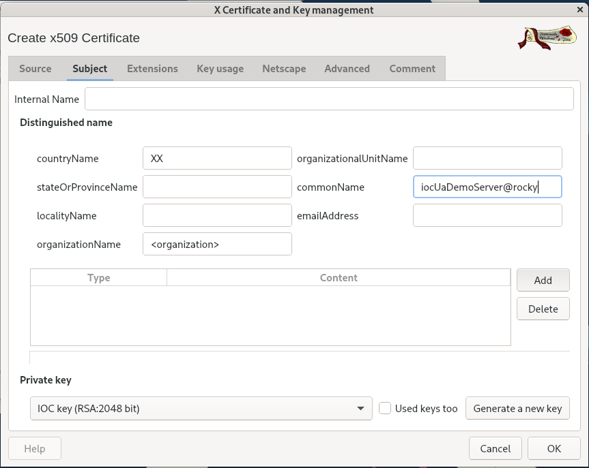
Create the IOC’s Client Certificate
Sub-Tab Subject
Minimal Setup:
Set the countryName to any two letters
Give it a nice commonName

Slide 20
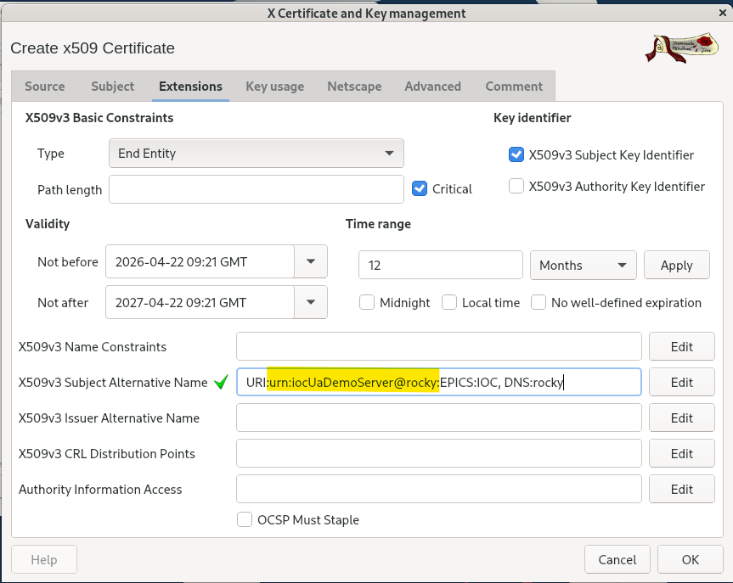
Create the IOC’s Client Certificate
Sub-Tab Extensions
Important Setup:
In the extensions, replace the placeholders <IOC> and <HOST>
The URI must match what the IOC uses
You can use IP: instead of DNS:
Click OK

Slide 21
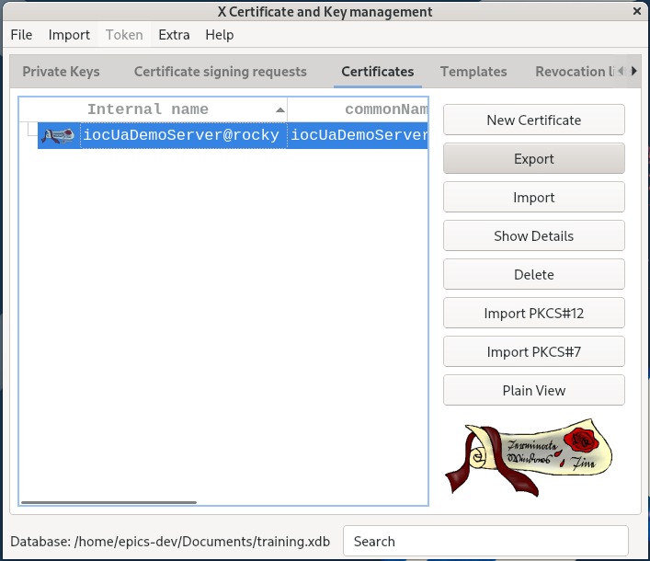
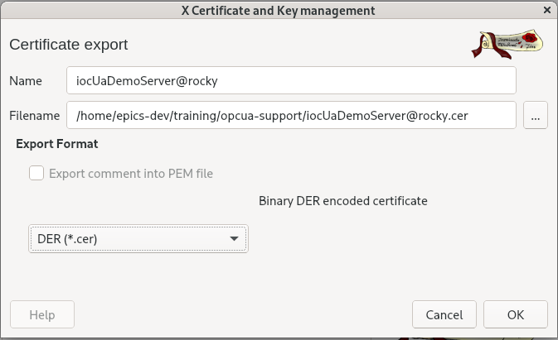
Export the Certificate
Tab Certificates
Select the certificate
Button Export
Select DER format
Click OK
Exit xca

Slide 22
Set Up the IOC’s PKI File Store
Create the minimal necessary directories for the IOC PKI file store
Move the created self-signed Client Certificate and its private key into it

Slide 23
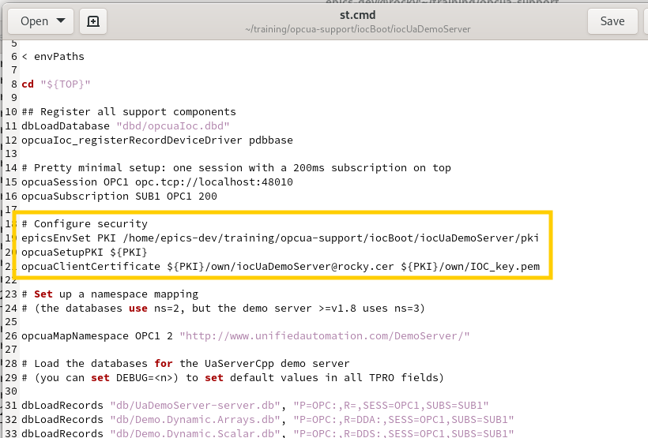
Configure the IOC to use Security
Edit st.cmd (gedit is available)
Remove the setting that switches off Security
Instead:
Set the location of the PKI file store
Load the client certificate

Slide 24
Establish Trust
Remember that trust needs to be established both ways:
Make the IOC trust the Demo Server’s certificate copy the server certificate in the IOC’s trusted/certs store
Make the Demo Server trust the IOC’s certificate copy the IOC certificate in the server’s trusted/certs store
Start the IOC … and …

Slide 25
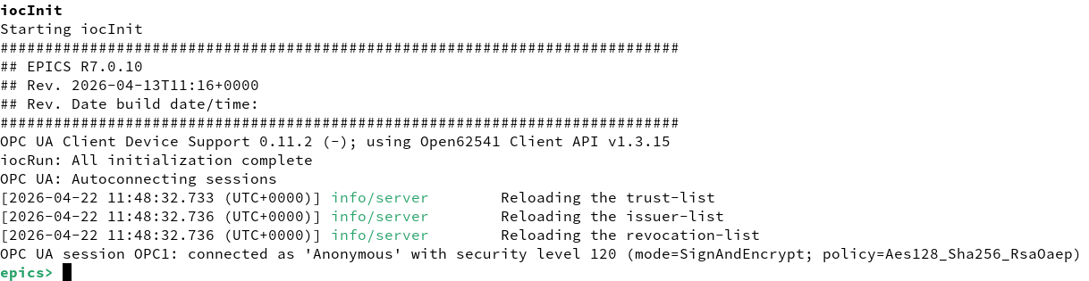
Connect securely
… and … yay!

Slide 26
Using CA-Based Certificates
Very similar, but different:
Create your CA: a new key and a self-signed CA certificate
Export the CA Certificate
Create a new IOC Client Certificate, containing the IOC key, but sign it with the CA key (instead of self-signing)
Export the IOC Client Certificate and copy it to the IOC’s own folder
Change the st.cmd file to load the new Client Certificate
Create a new empty CRL, signed with the CA key
Copy into the server PKI: the CA certificate (into trusted/certs) and the CRL (into trusted/crl)

Slide 27
Using CA-Based Certificates
Remember that I said “be prepared for a lot of frustration” ??
I verified this workflow in trustworthy documentation places (and using AI, obviously)
I spent a few hours yesterday creating and exporting certs and CRLs, experimenting with formats, file suffixes and locations
I could not get the f*@&#^$*&^$@!! thing to connect: “BadSecurityCheckFailed”
I am sorry. I will eventually get it to work and send you the updated slides.

Slide 28
Thanks for Your Attention!
Any questions left unanswered?
OPC UA room on EPICS Chat

